Slide 1
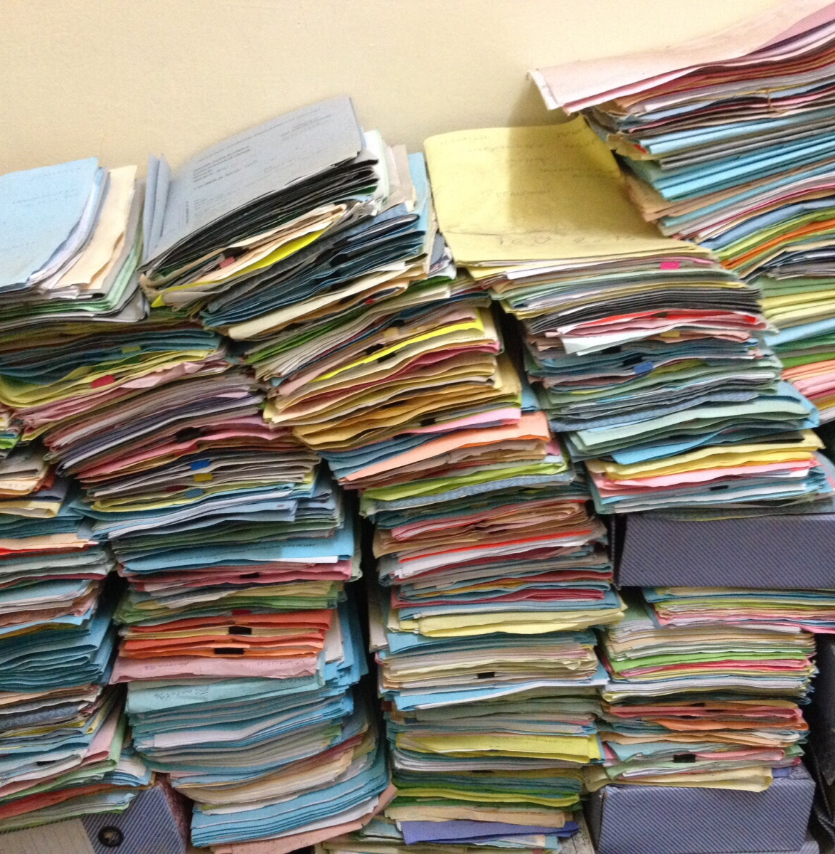
11. Other capabilities
©CarlesBarcenaRoig

Slide 2

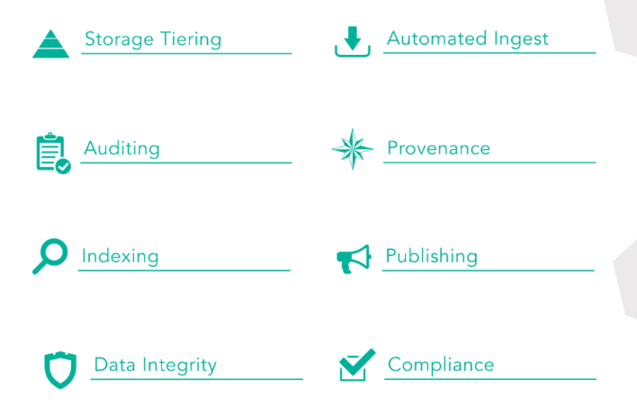

Other iRODS capabilities
©created by iRODS

Slide 3
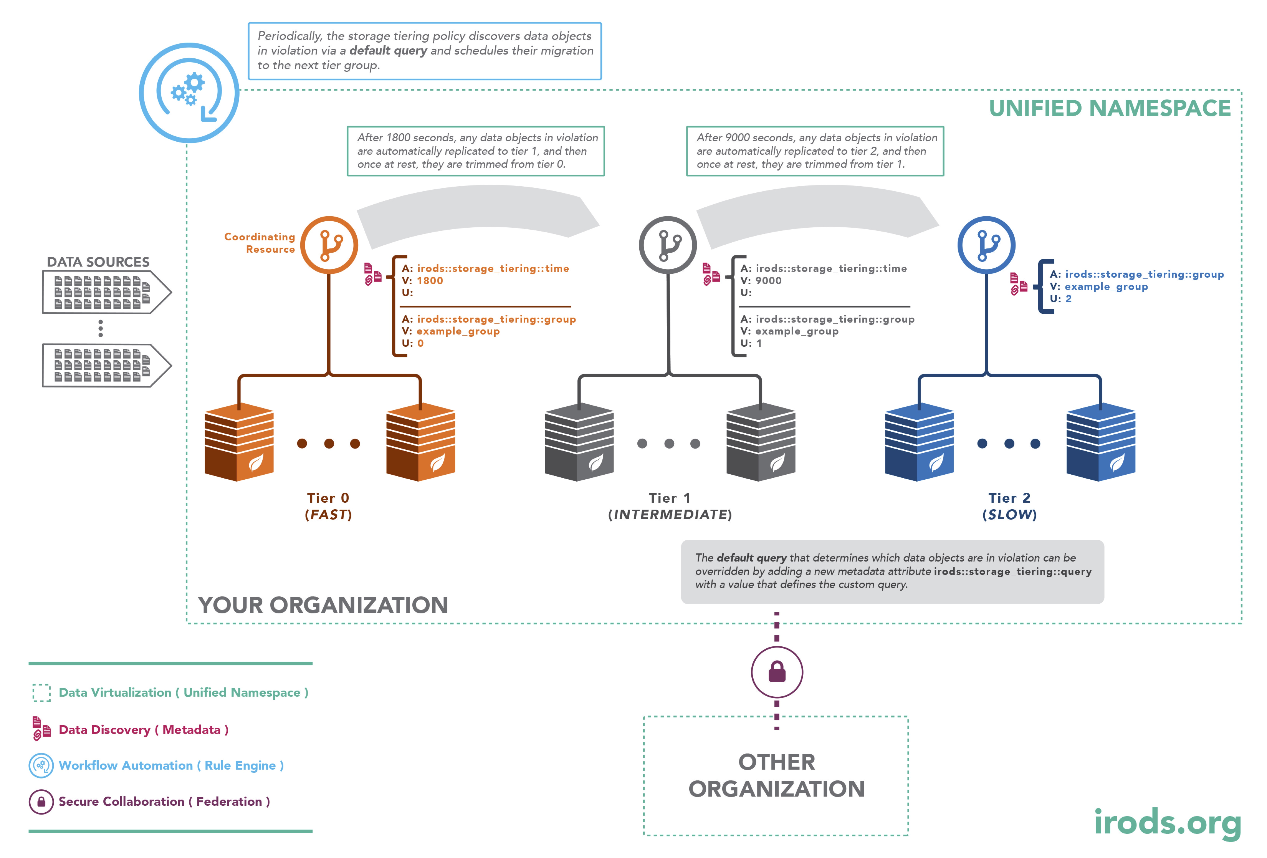
Storage Tiering
In test in the Tier-1 Data platform
Use case:
Production environment
Move data between 2-3 types od storage:
Hot - warm - cold

Slide 4
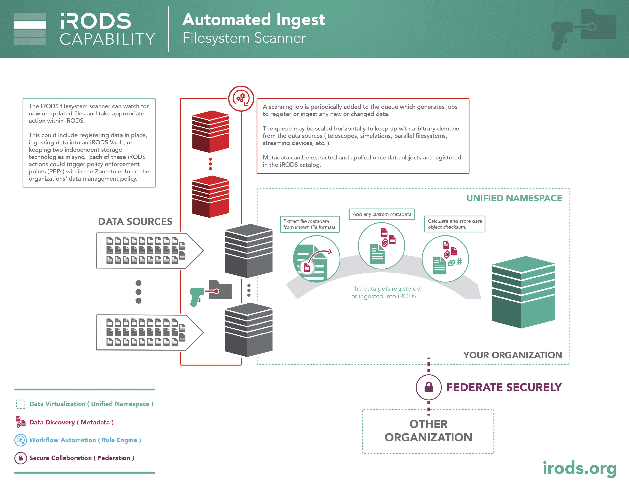
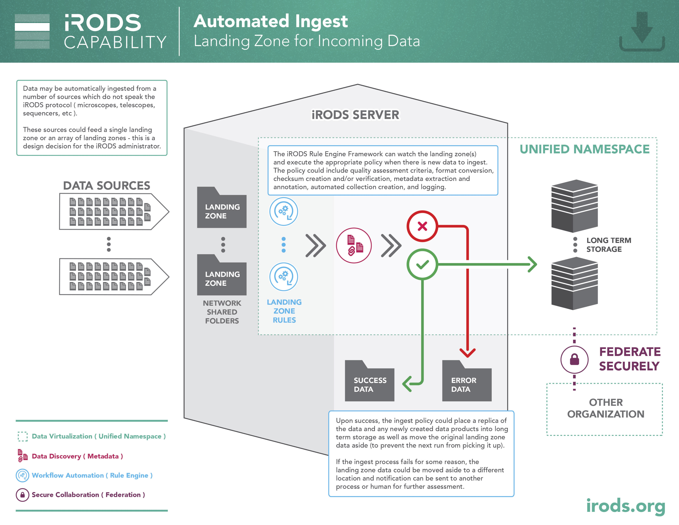
Automated ingest/Landing zone

Slide 5
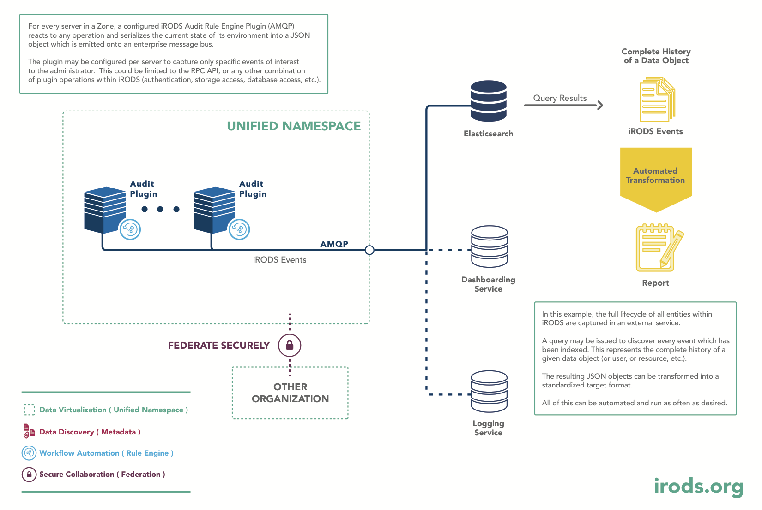
Auditing/Provenance

Slide 6
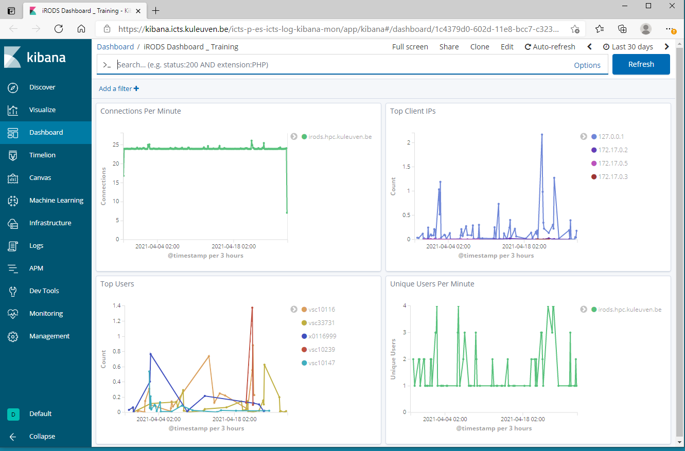
Kibana dashboard

Slide 7
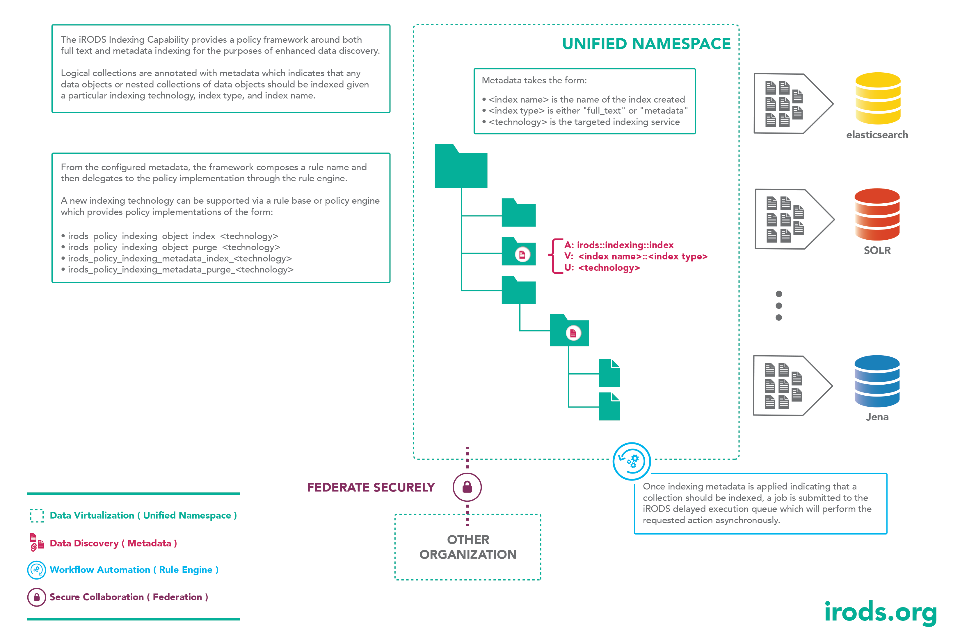
Indexing

Slide 8
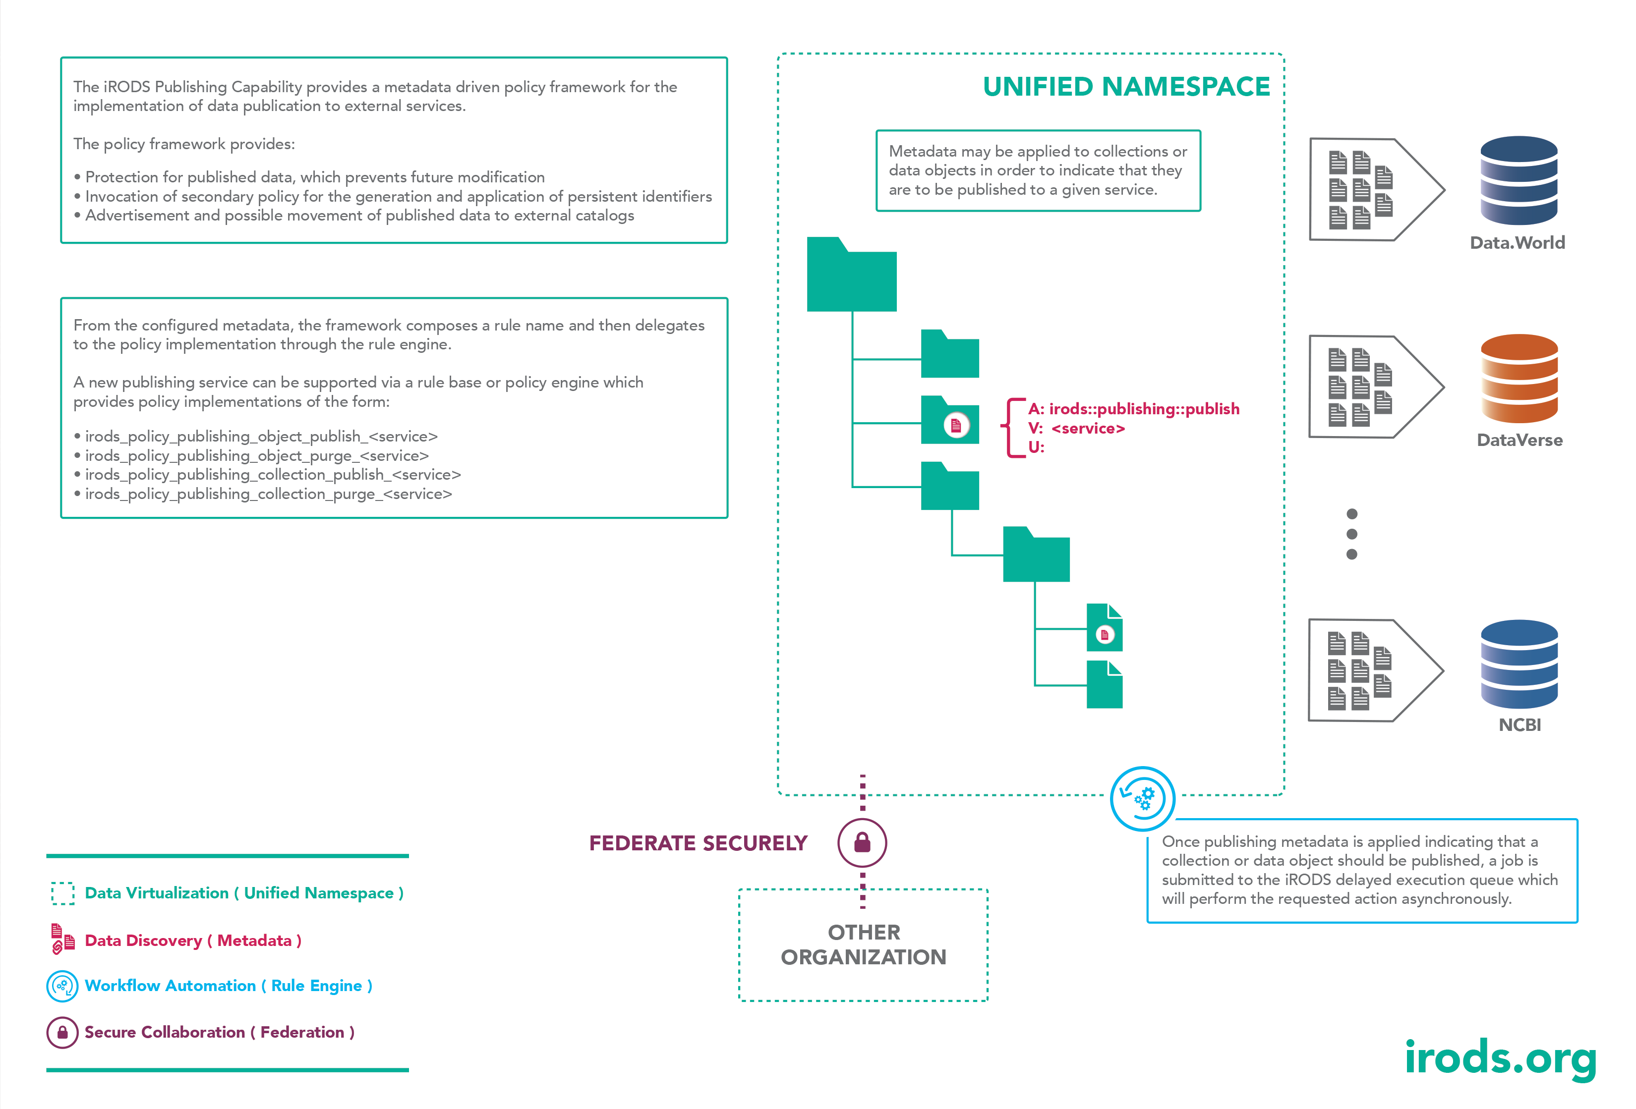
Publishing

